Slide 1
UK’s recent life expectancy slowdown: not due to reaching a natural limit
Dr Jon Minton
Jon.minton@nhs.net
Public Health Intelligence Adviser
NHS Health Scotland

Slide 2
Background
Recent slowdown in life expectancy improvement in UK
Life expectancies have kept improving in high income countries for decades
Intuitive assumption: as life expectancy increases, further gains in life expectancy become ever harder to achieve
Twin phenomena:
Long-term improvements
Tendency for improvements to slow down over time

Slide 3
Example
“The slowdown in UK life expectancy since 2010 appears to have been driven largely by declining improvements in YLL from ischaemic heart disease and stroke, with increasing YLL from lower respiratory tract infections and cancer also contributing. Further research is needed into the causes of these condition-specific changes, including the effects of austerity and international comparisons to explore the extent to which further improvements in life expectancy are biologically possible.”
Source: Parry, Steel & Ford (2018), “Slowing of life expectancy in the UK: Global Burden of Disease Study 2016”, Lancet Meeting Abstracts
https://www.thelancet.com/journals/lancet/article/PIIS0140-6736(18)32906-4/fulltext

Slide 4
Questions
Is are these twin phenomena – gains and slowdowns – ‘true’ (for now)?
Do any general tendencies towards slowdown explain recent slowdown/decline in UK?

Slide 5
Approach
Review/summarise two key empirical findings on
Life expectancy trends
Life expectancy slowdown
As long-term, predictable, international phenomena
Repurpose the above analysis to explore:
How the UK compares against other high income countries
Whether long-term, international tendencies towards slowdown explain the recent slowdown in the UK

Slide 6
The Keystone paper: White (2002)
White, K.M. 2002. “Longevity Advances in High-Income Countries, 1955-96.” Population and development review 28(1), pp. 59–76.
Abstract:
The advance of life expectancy within high‐income countries from 1955 to 1996 is well represented by a straight‐line trend. This explains more of the variance on average, and in 19 of 21 high‐income countries, than logged or unlogged age‐standardized death rates. Change in life expectancy in individual countries over this period was partially predicted by a country's level relative to the rest of this group of high‐income countries and partially by a country's own prior rate of advance, with substantial convergence toward the group mean for both measures.

Slide 7
First Claim: Life Expectancy Improvements are Linear
Data:
Unweighted average of 21 high income countries (including UK as one country)
From 1955 to 1996
Source: Human Mortality Database
Method:
Scatterplot
Linear regression line of best fit
R² value

Slide 8
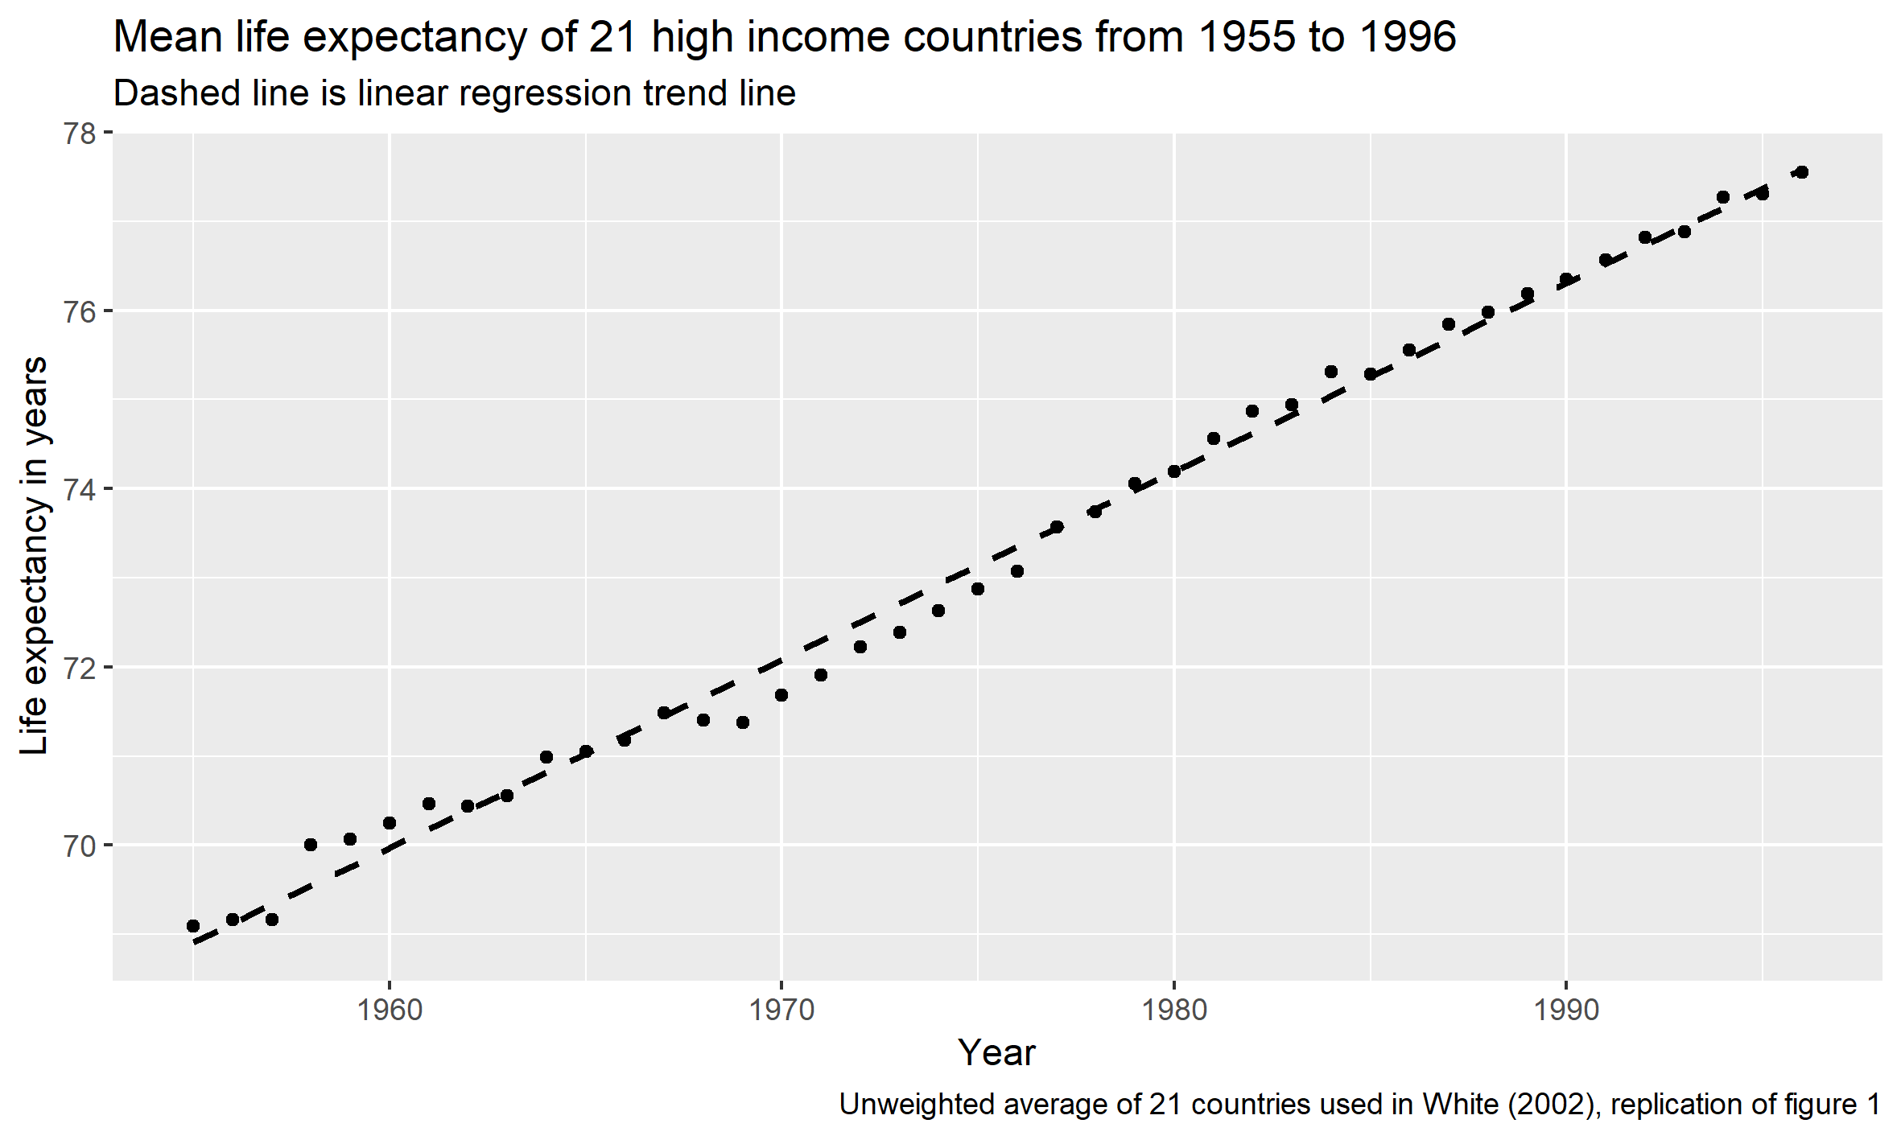
First claim: Replication

Slide 9
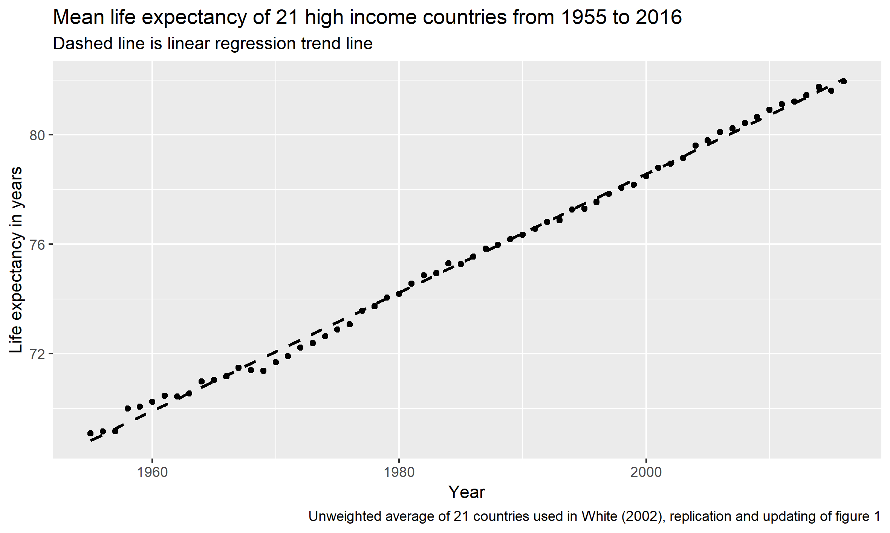
First claim: Updating

Slide 10
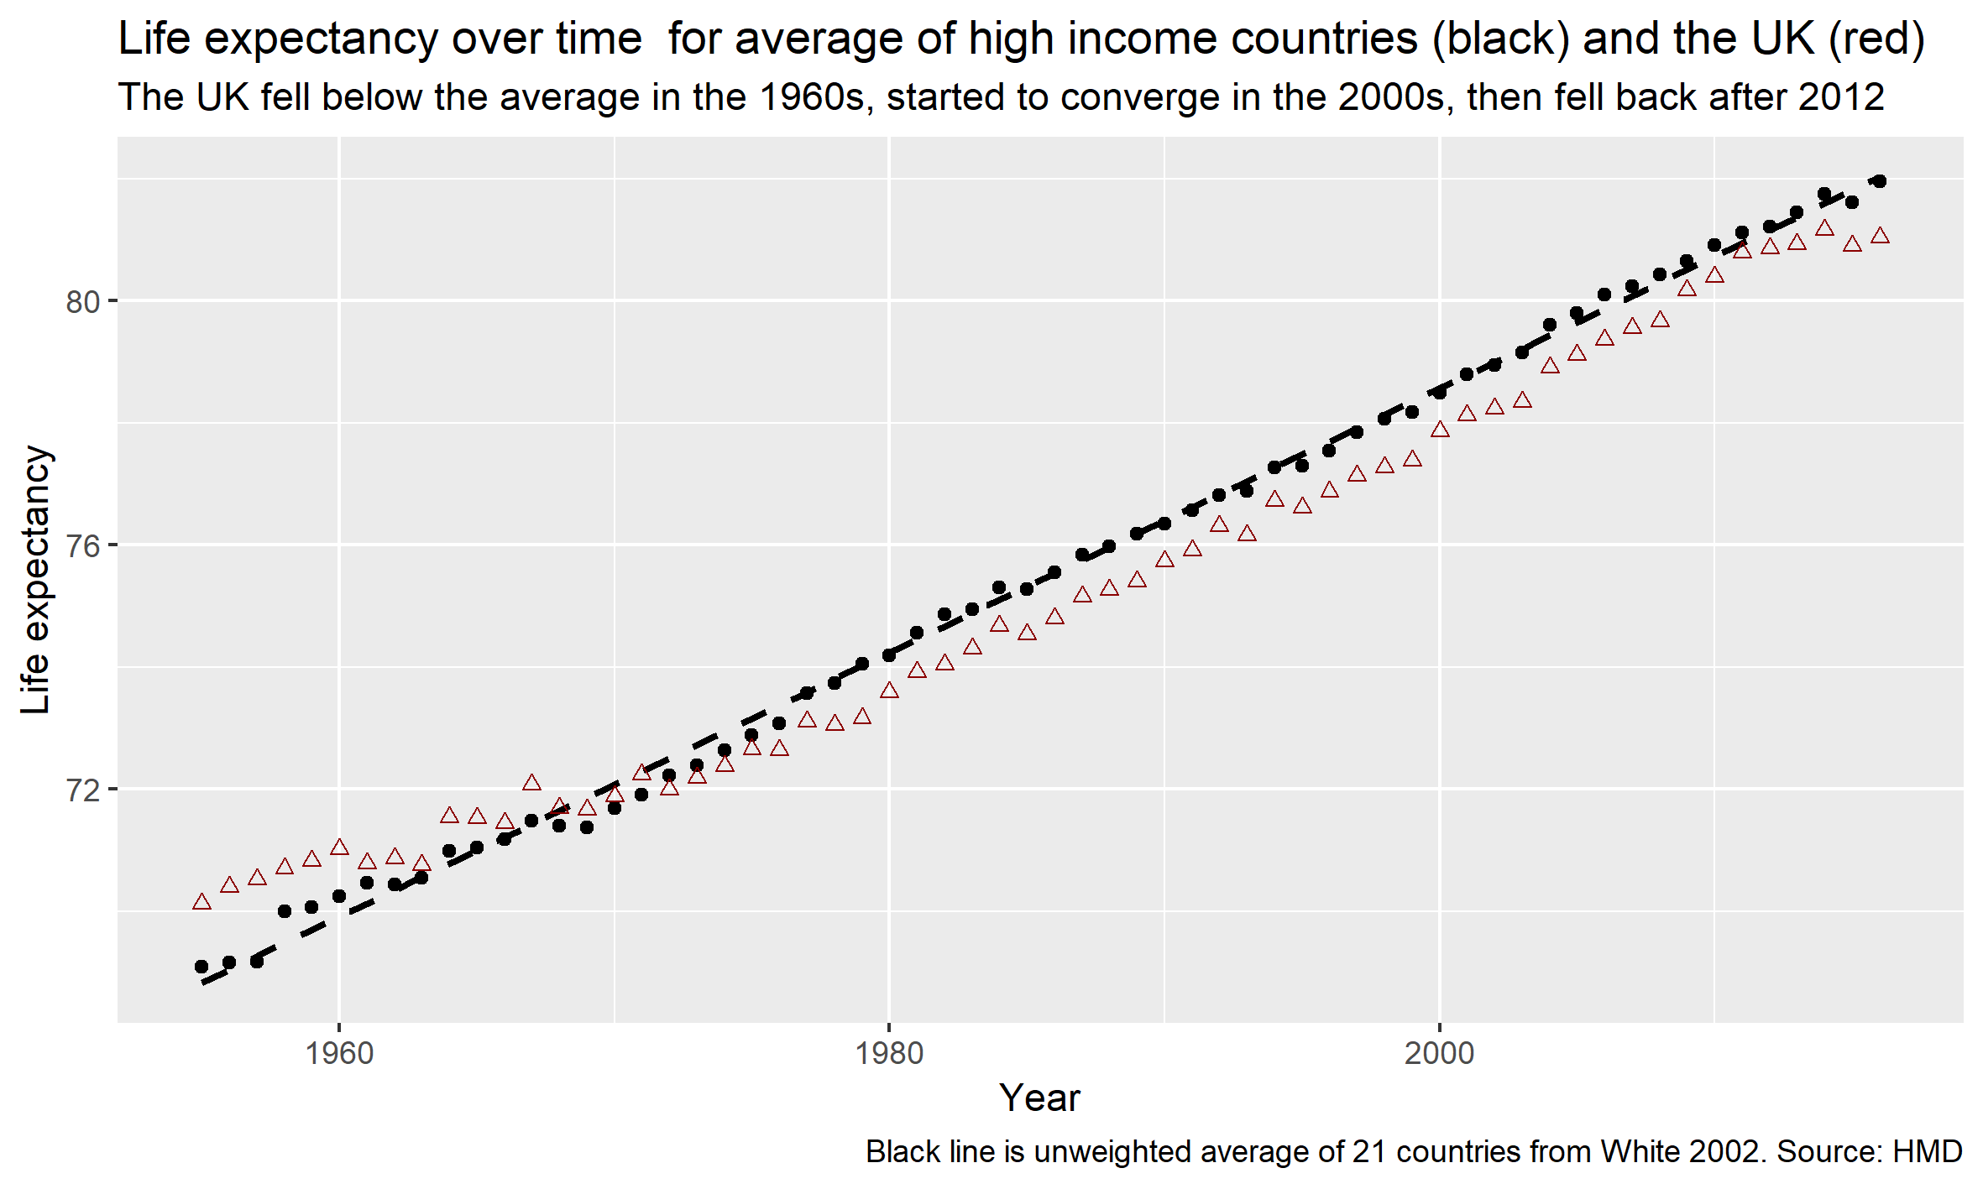
First claim: UK’s relative position

Slide 11
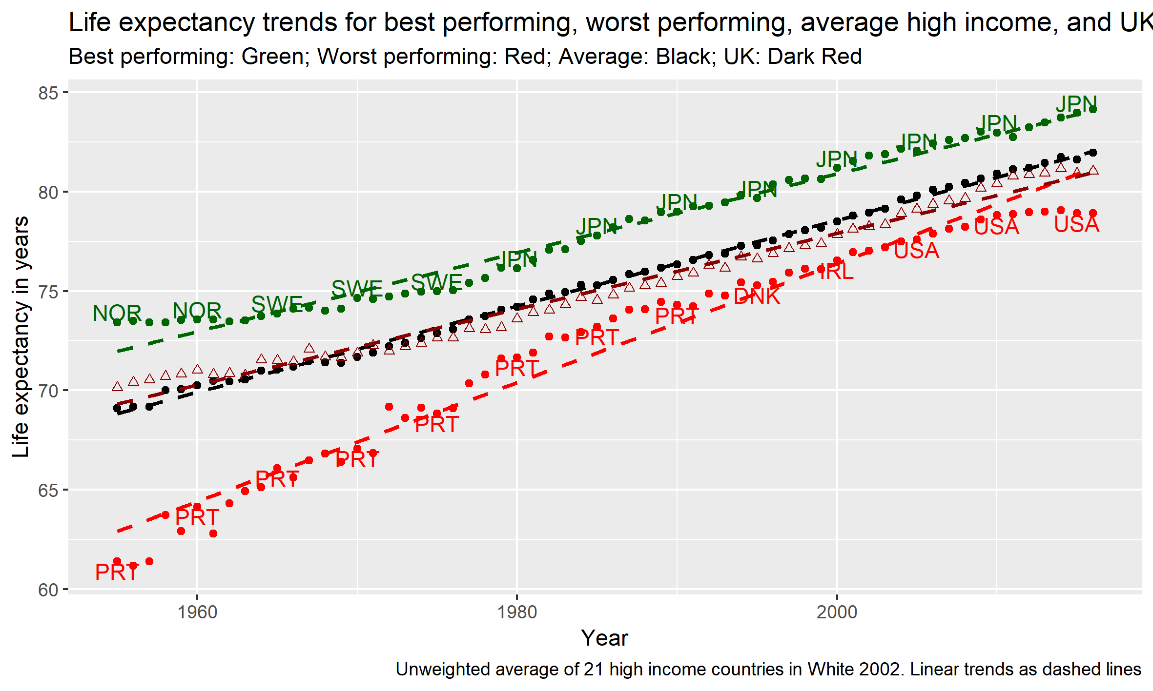
First claim: UK relative to average, best performing, and worst performing

Slide 12
Second Claim: Improvements Fall as Life Expectancy Rises
Data:
Life expectancy in 1955
Average annual change in life expectancy from 1955-1996
21 high income countries
Source: Human Mortality Database
Methods:
Scatterplot
Regression line
Descriptive interpretation

Slide 13
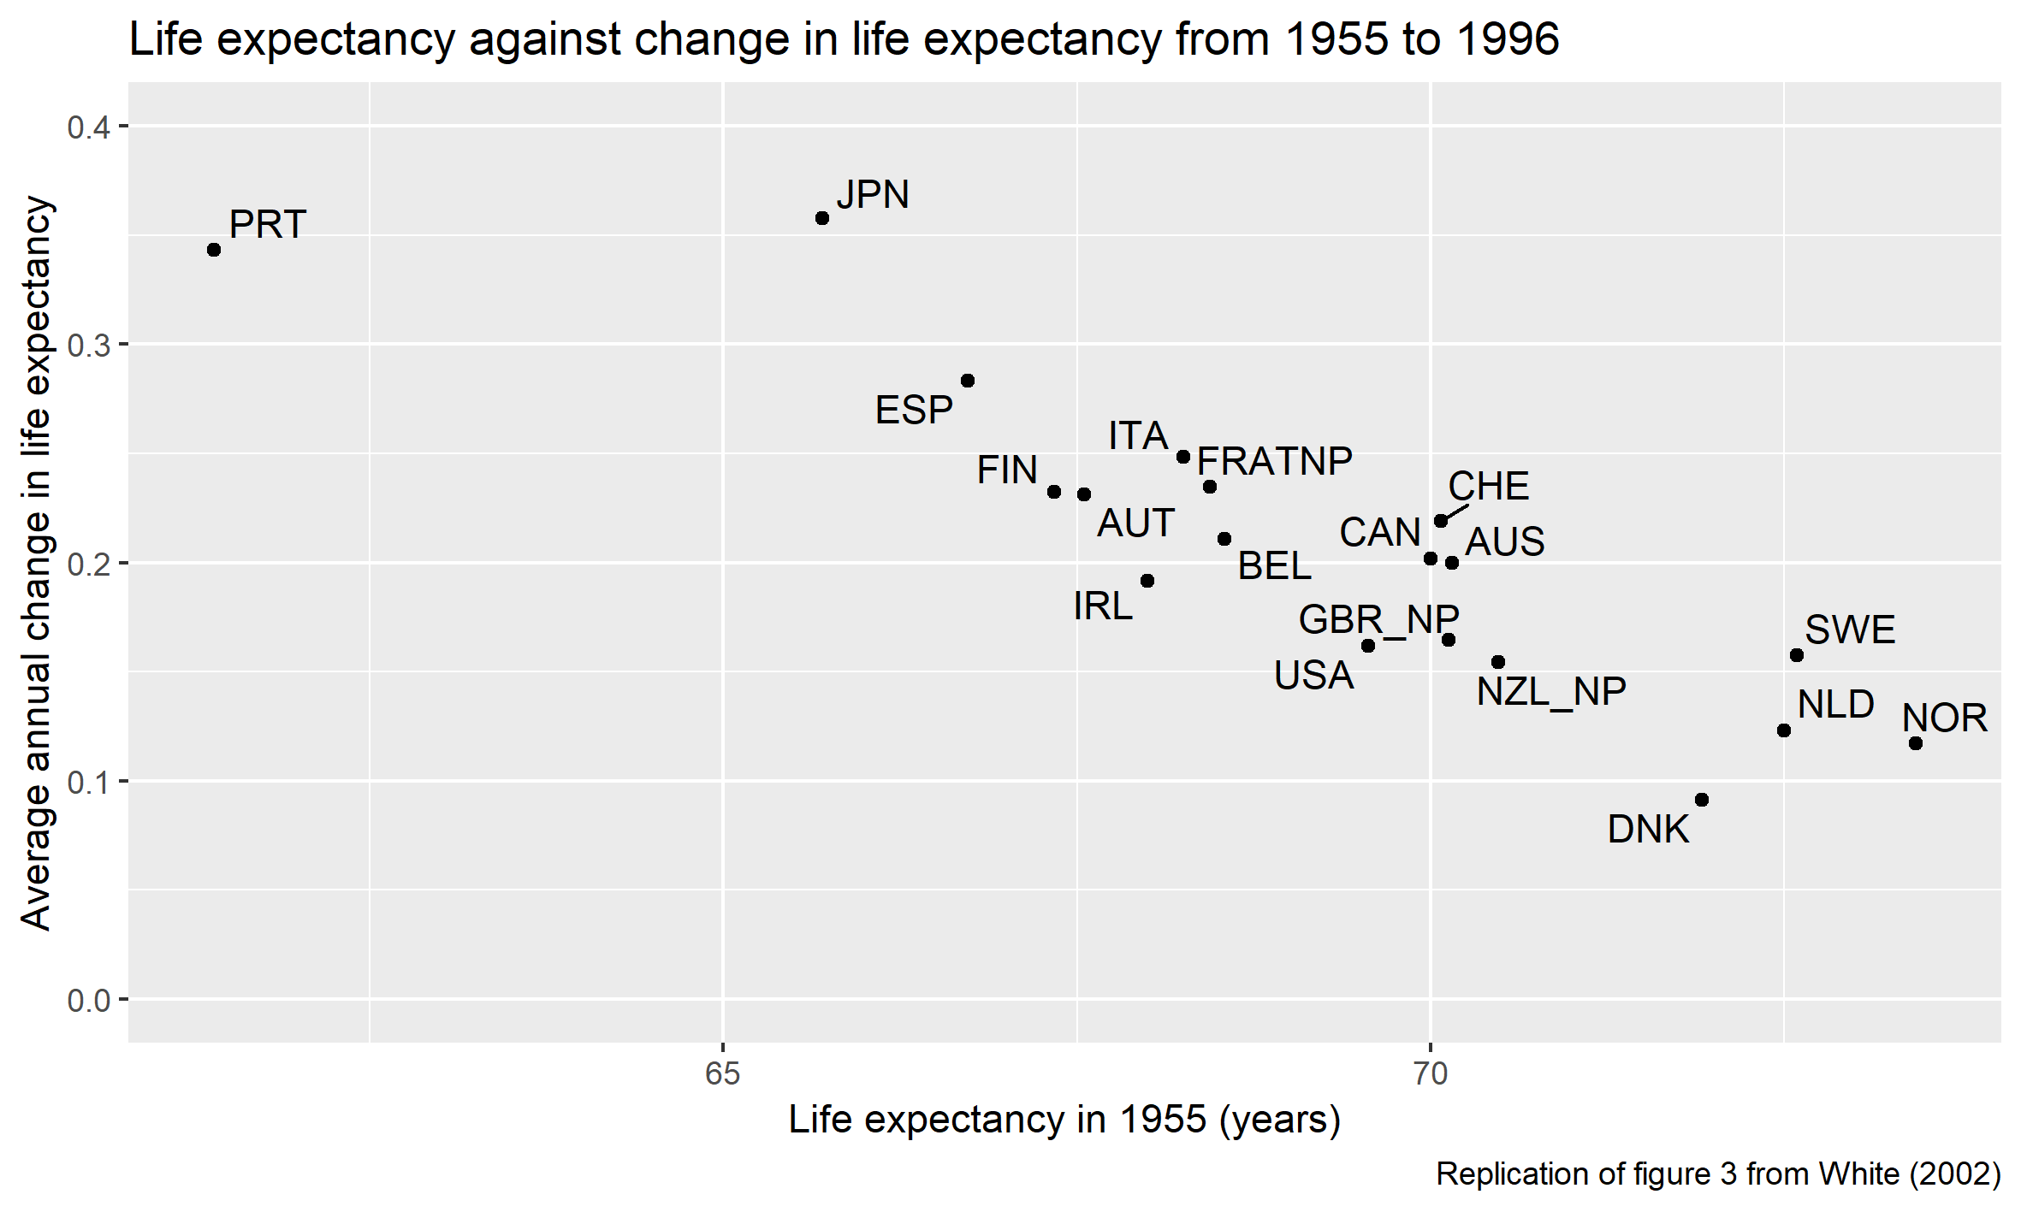
Second Claim: Replication

Slide 14
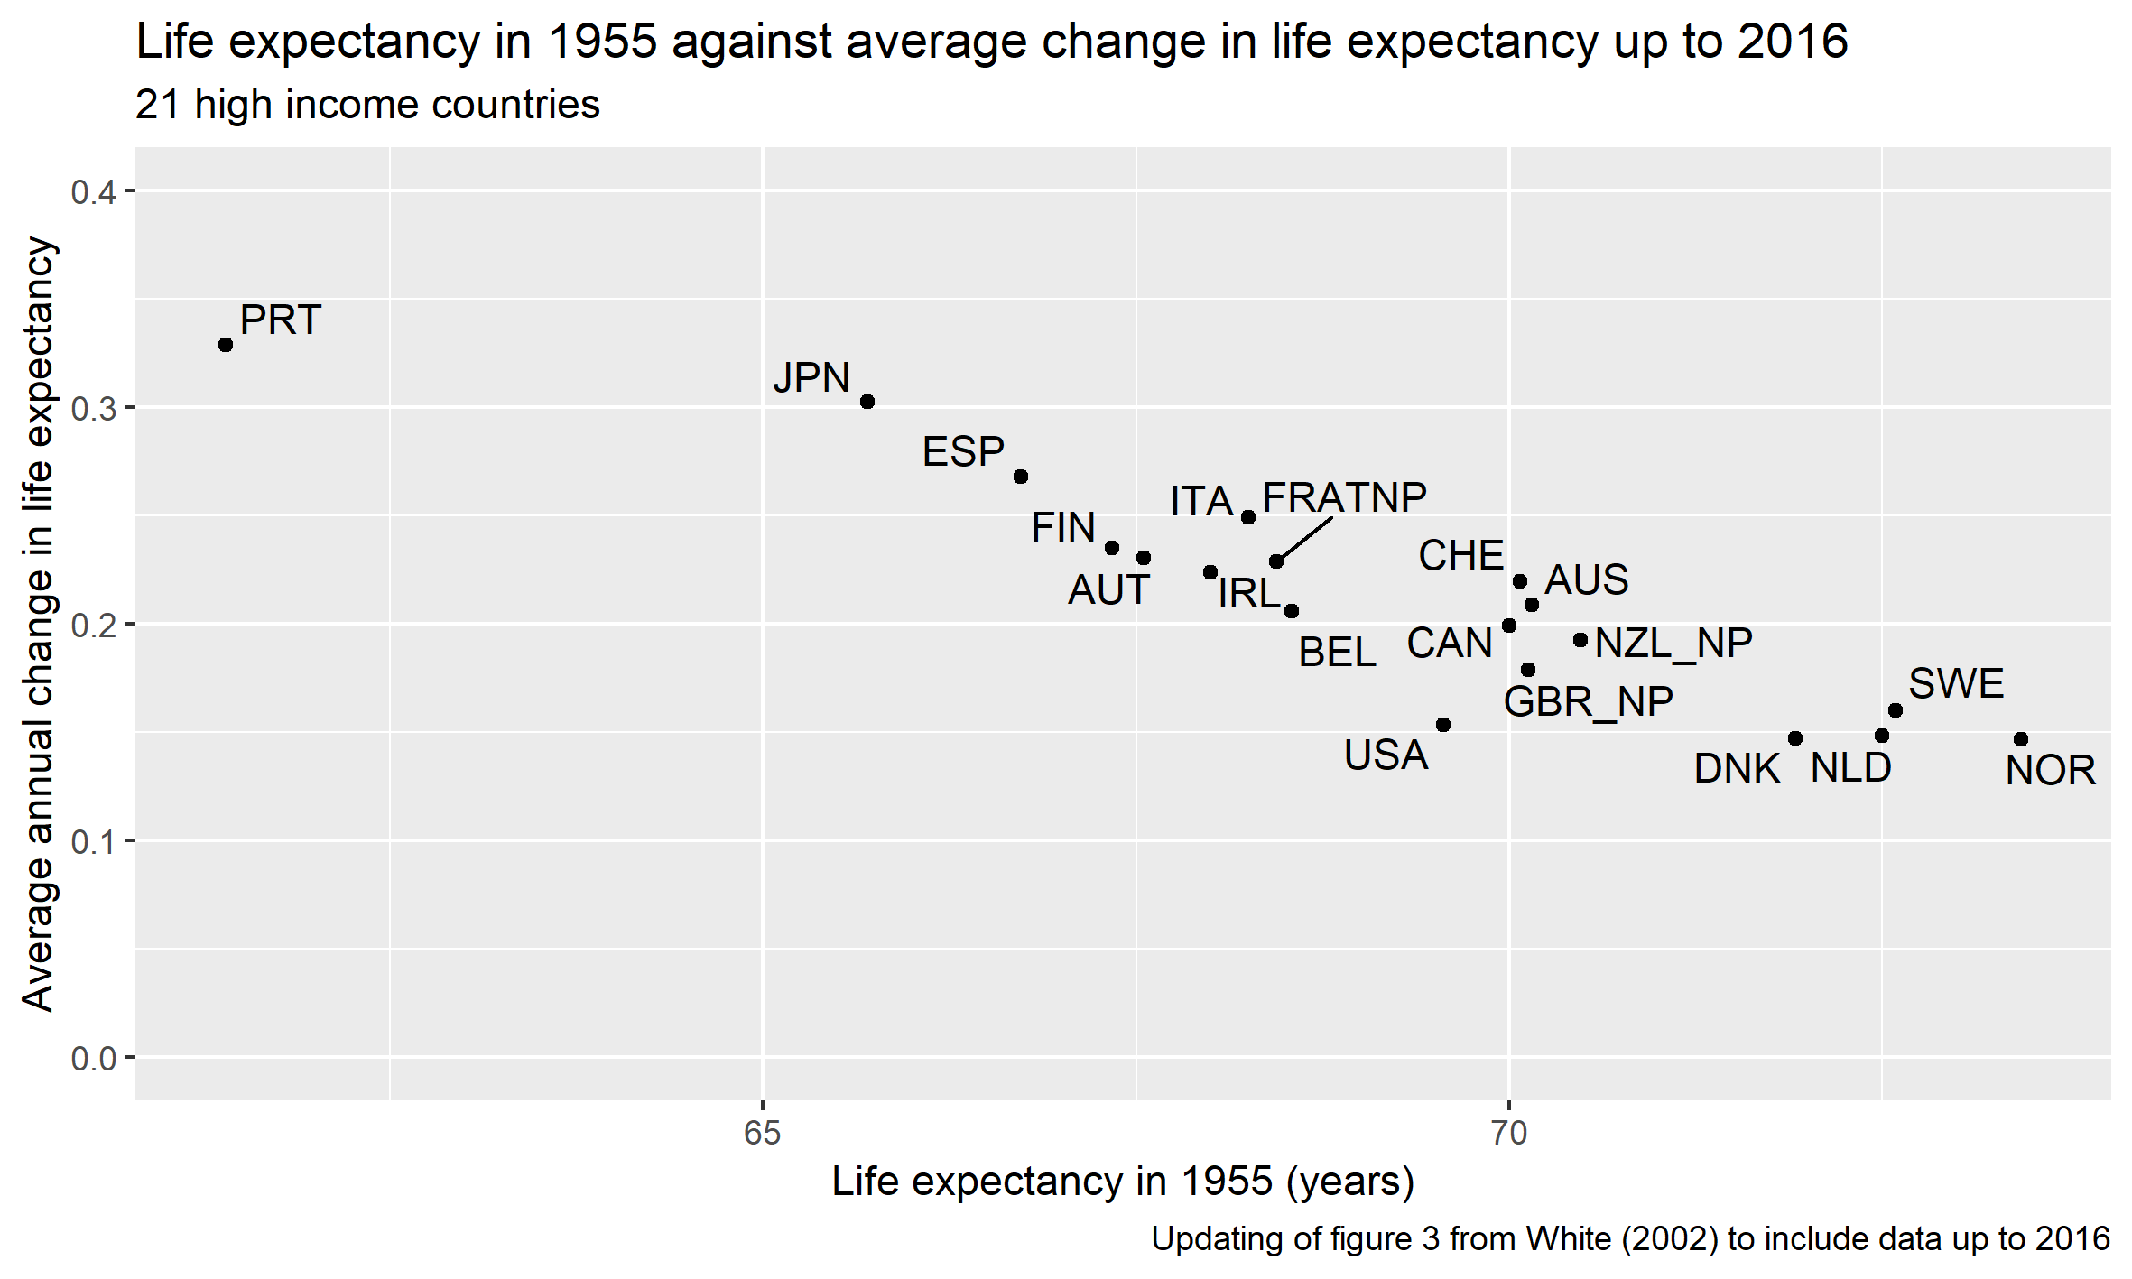
Second Claim: Updating

Slide 15
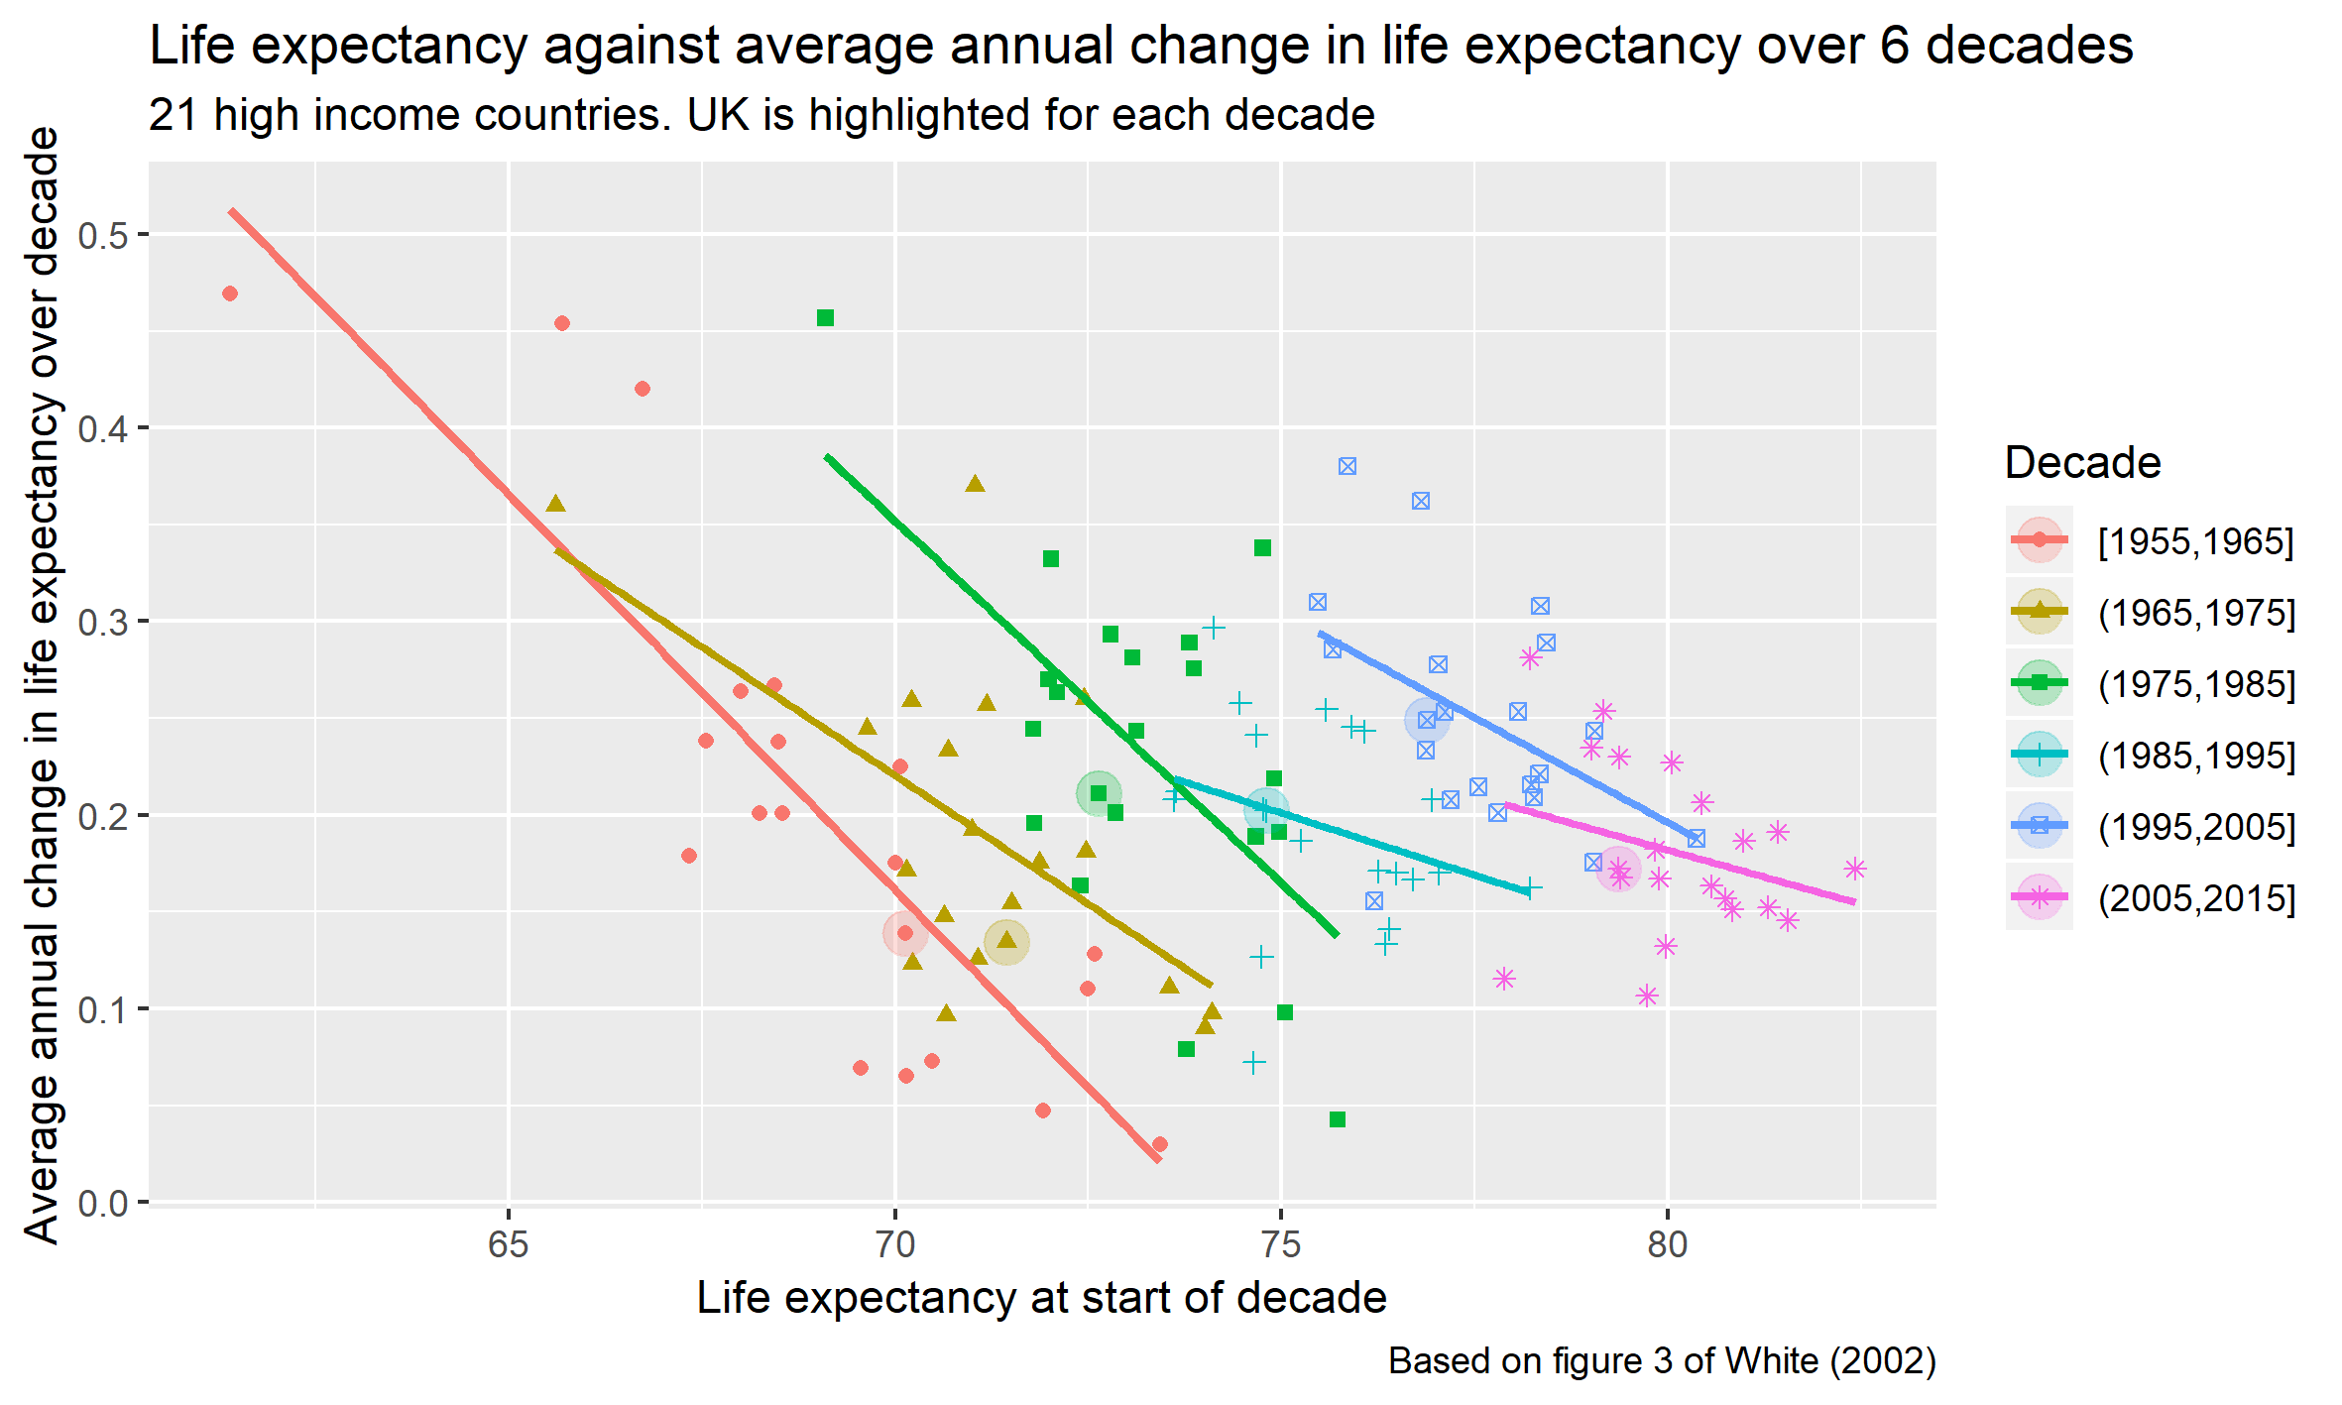
Second Claim: Trend by mid-decade

Slide 16
Overall Summary
Life Expectancy Trends:
Assumption of linear improvements OK
Lee 2002 response to White 2002
Can also use standard deviation of annual change in life expectancy to set thresholds for what counts as an ‘unusual’ year or group of years
UK’s relative position
Fell in 60s; converging in 90s-2000s; fell back again after 2012
Slowdown in improvement
A slowdown in the slowdown: converging to ~1.5 years gain/decade (0.15 years/year)
UK’s fall in relative position, and improvements at below 0.15 years /year, mean long-term secular declines in improvement do not explain UK’s recent slowdown.

Slide 17
Supplementary Material
(More Wonkish)

Slide 18
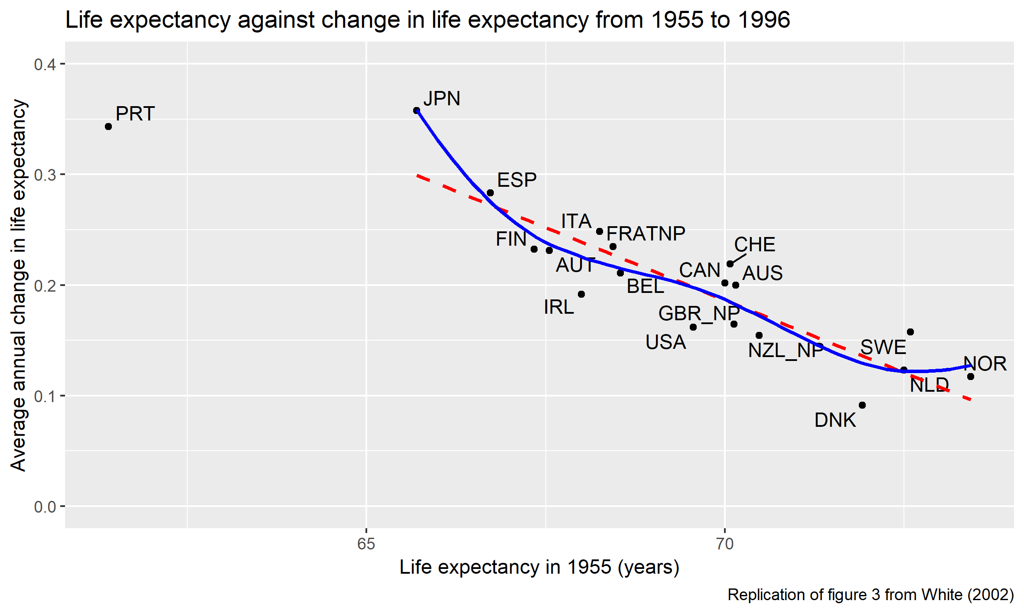
Original with Linear and Nonlinear Smoothers

Slide 19
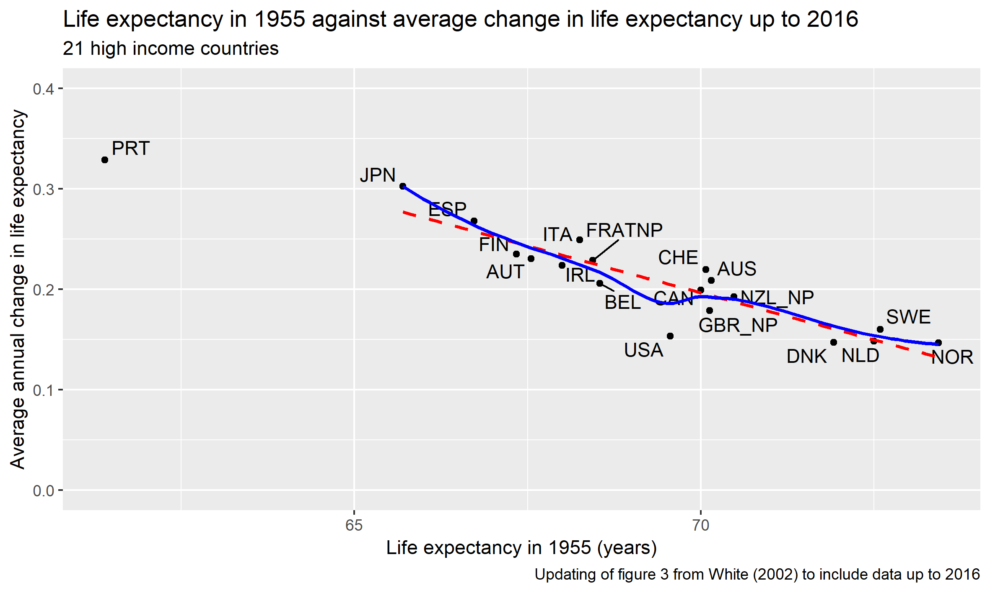
Updated with Linear and Nonlinear Smoothers

Slide 20
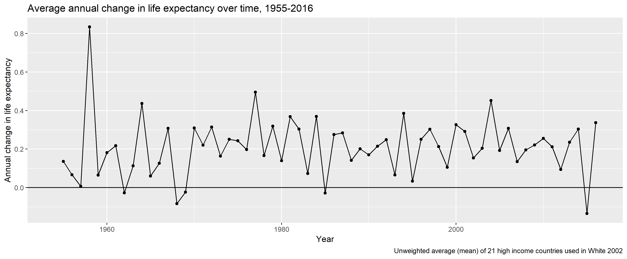
Average high income countries, change over time

Slide 21
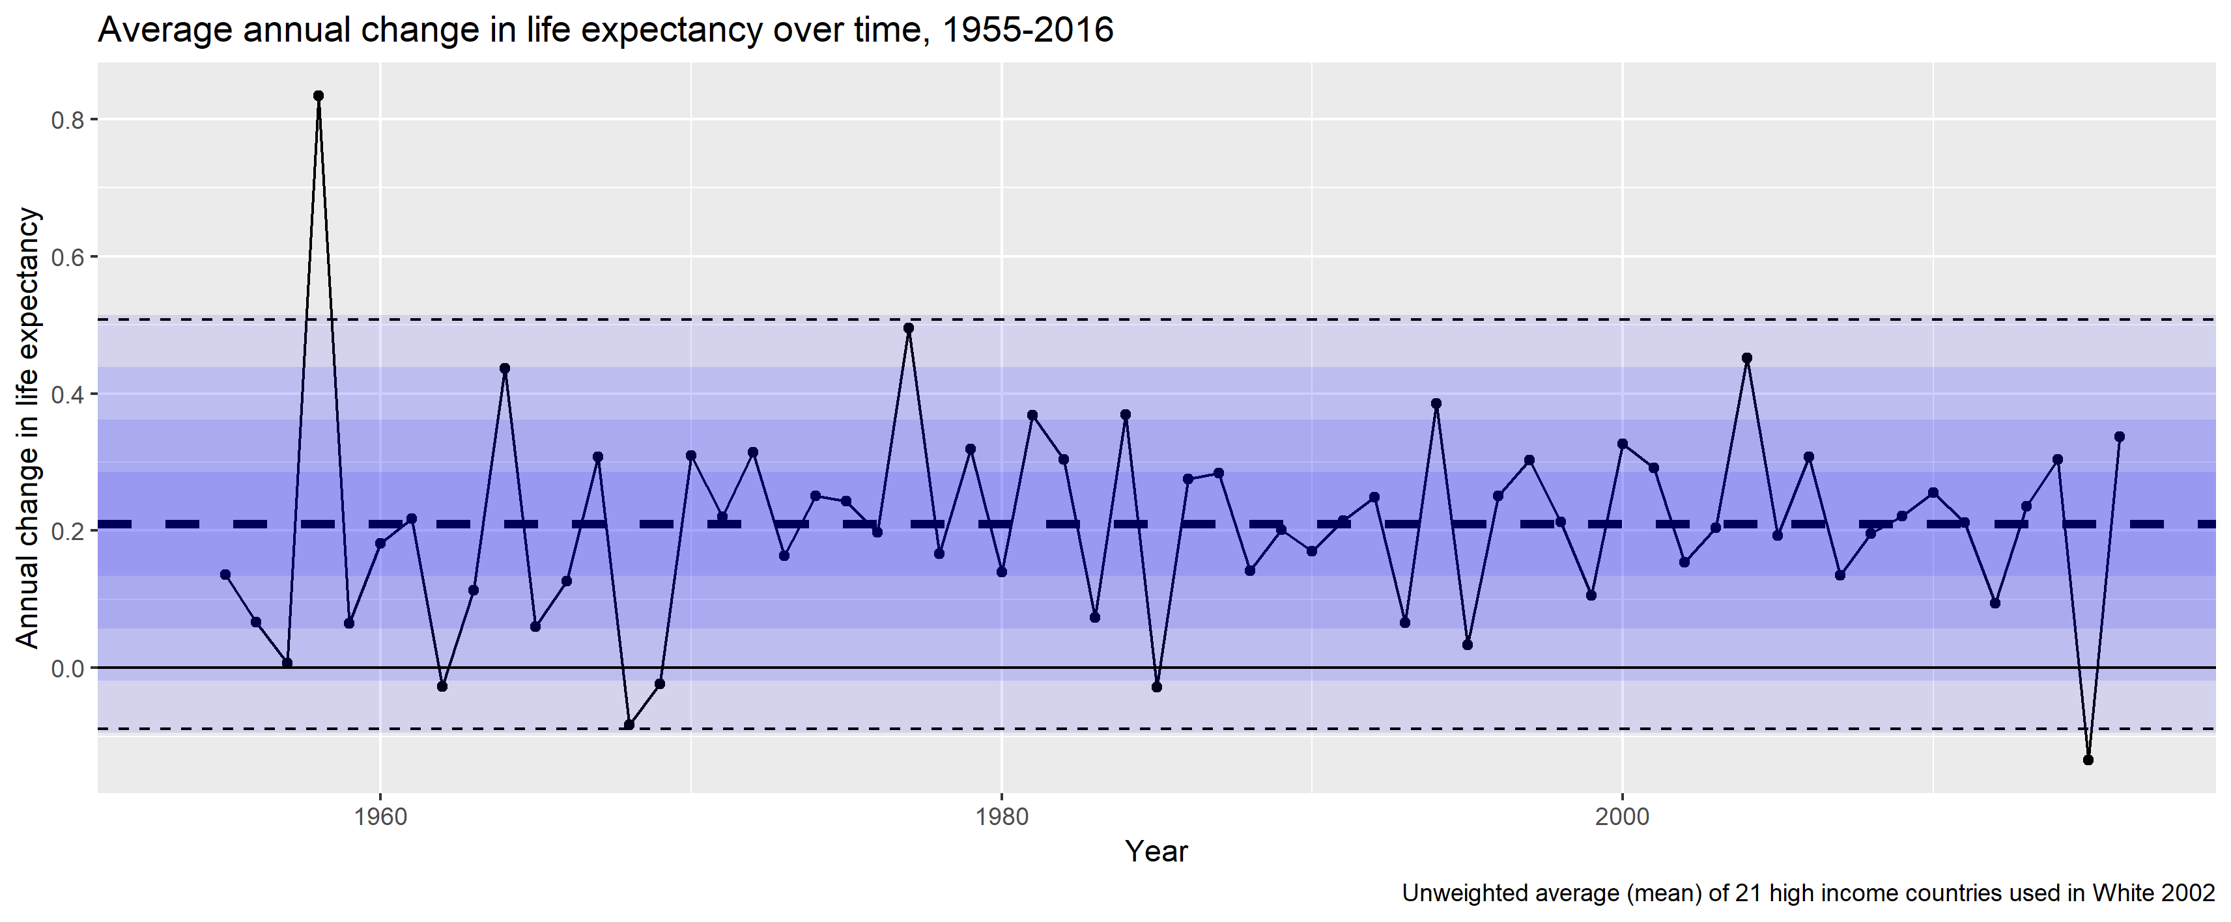
Average high income, change over time, with bars at 0.5 SD intervals

Slide 22
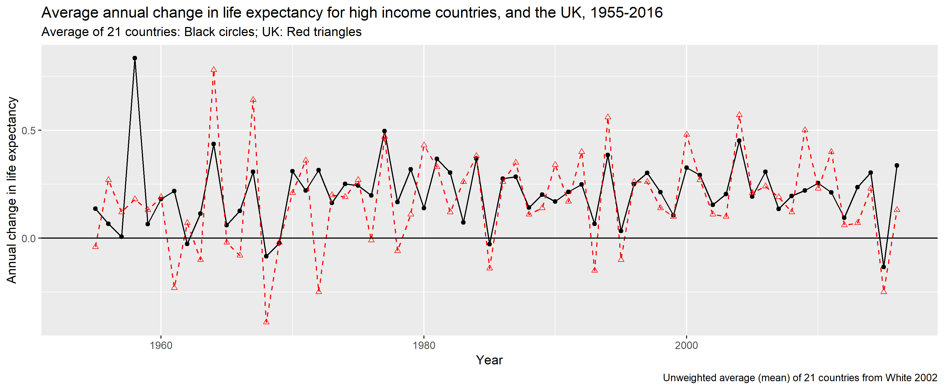
Change over time, UK compared with average high income countries

Slide 23
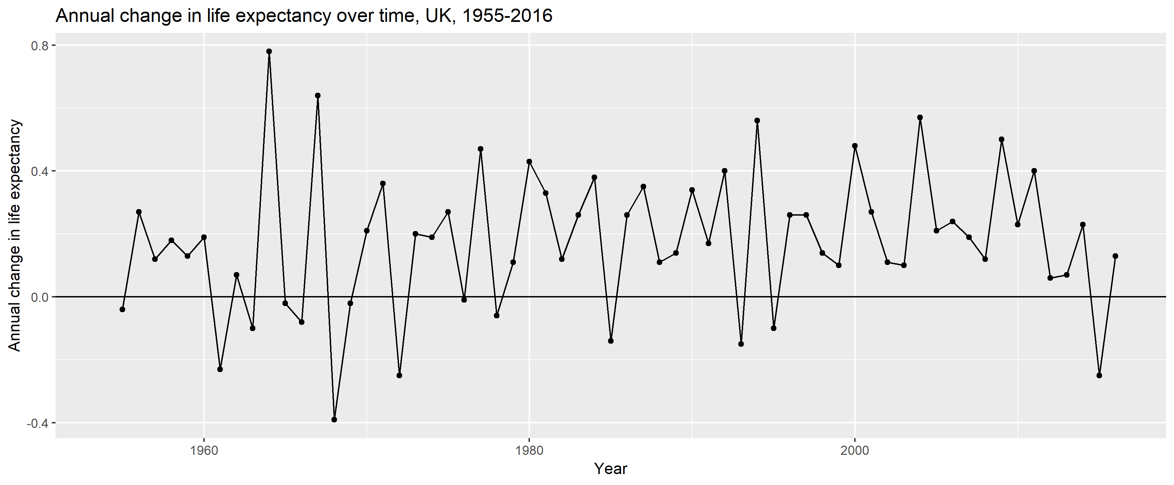
Change over time, UK

Slide 24
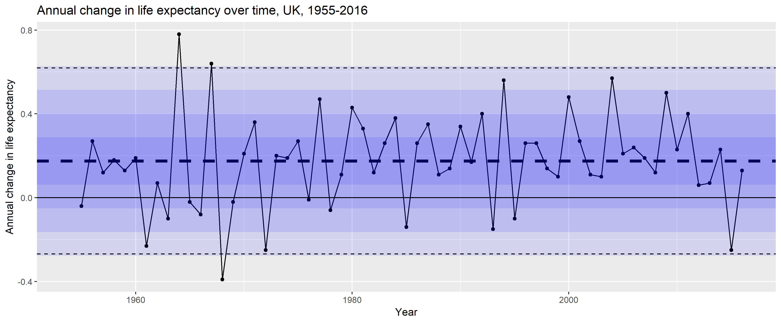
Change over time, UK, with bars at 0.5 SD intervals

